Slide 1
Triangle
A figure with three straight sides and three angles is called triangle.
sum of angles in a triangle
In a triangle, the three interior angles always equal to 180º.
Press to play

Slide 2
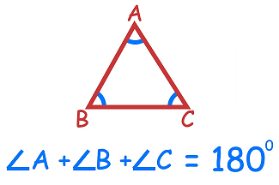
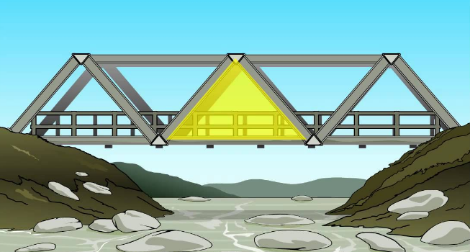
Press to play

Slide 3
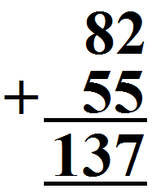
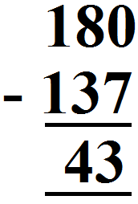
Find out unknown angle in the given triangle.
? + 82º + 55º = 180º
180º - 137º = 43º
Press to play

Slide 4
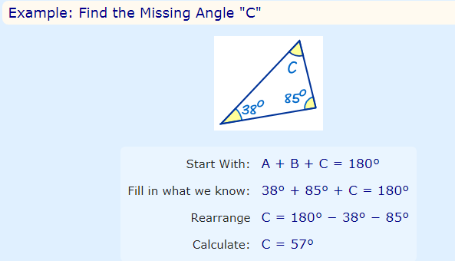
Press to play

Slide 5
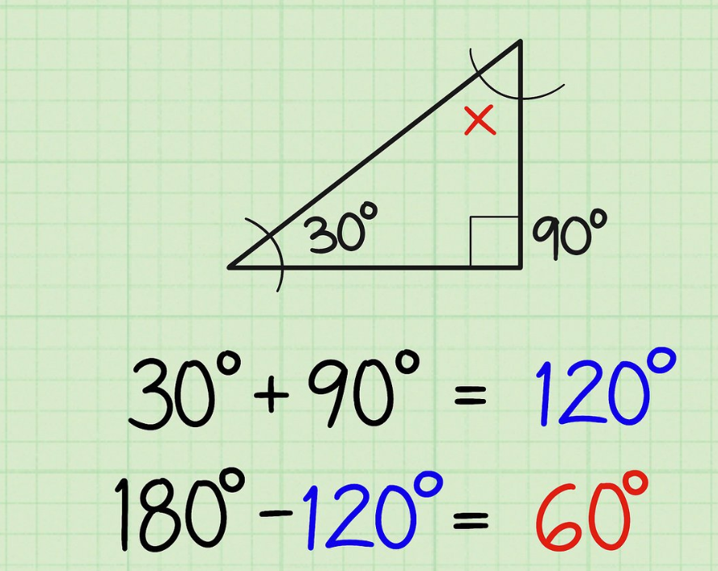
Homework : Do pages 81 and 82 in workbook 5B.
Press to play

